Slide 1
DIGITAL LOGIC & DESIGN
INTRODUCTION
LECTURE 1

Slide 2
Course Policy
Policy for the distribution of marks and
examination is as follows
Quiz 10%
Assignments 10%
Sessionals 15% + 15%
Project 10%
Final 40 %

Slide 3
Course Policy
Assignments:
Total Number of Assignments 4
Assignments will be marked on submission and performance of your quizzes
Assignment | Chapter | Announcement Time | Submission
A1 | 1&2 | Week 3 | Week 4
A2 | 3 | Week 6 | Week 7
A3 | 4 | Week 7 | Week 8
A4 | 5 | Week 12 | Week 13

Slide 4
Course Policy
Quizzes
As Many As I Like………

Slide 5
Course Policy
No late submissions
No Late Arrivals.
No disturbance in Class
No use of Mobile Phones(Keep them Silent and in your pockets)
No Retake of Unannounced Tests/Assignments
Student is responsible for his/her short attendance.

Slide 6
Reference Books
M. Morris Mano, Digital Logic and Computer Design
Other reference:
Thomas L. Floyd, Digital Fundamentals

Slide 7
GOOGLE CLASSROOM
Class Code: dgzgx4s

Slide 8
Objectives
Analog Systems
Digital Systems
Difference Between Digital and Analog Quantities
Advantages & Disadvantages of Digital & Analog systems

Slide 9
Analogue Quantities
Continuous Quantity
Intensity of Light
Temperature
Velocity
Time
Pressure
Sound
Notes:
9
Most of the quantities in nature that we can measure are continuous, for example the intensity of light, temperature, velocity all change continuously.
Temperature for example never rises in discrete steps like 37, 39, 43. The rise in temperature is continuous.
Youtube links:
https://www.youtube.com/watch?v=btgAUdbj85E

Slide 10
Digital Values
Discrete set of values
Notes:
10
Digital values on the other hand are a discrete set of values which represent the actual Continuous Signal.
Consider the continuous signal shown in the diagram.

Slide 11
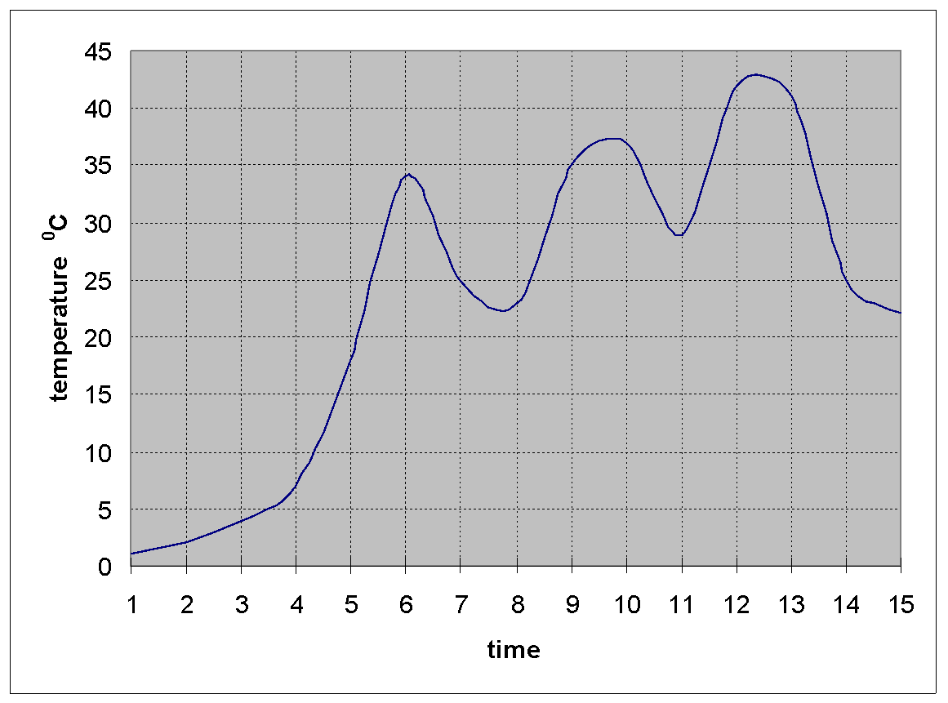
Continuous Signal
Notes:
11
The diagram shows a plot of temperature continuously varying with time.
The continuous signal might be representing the change in the intensity of light or velocity.
The continuous signal can be represented digitally by taking samples at regular but fixed intervals.

Slide 12
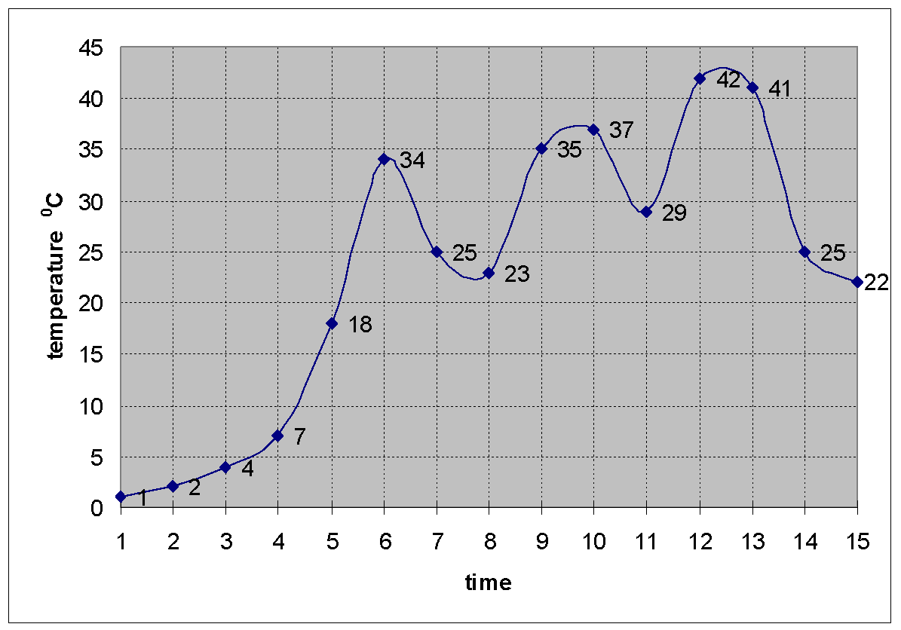
Continuous Signal
Notes:
12
In this case 15 samples at regular time intervals are collected.
The 15 samples having the values 1, 2,4,7,18,34,25,23,35,37,29,42,41,25 and 22 represent the continuous signal digitally.
The digital representation of the continuous signal only approximates the original signal and does not truly represent the original signal as can be seen by plotting the digital values.

Slide 13
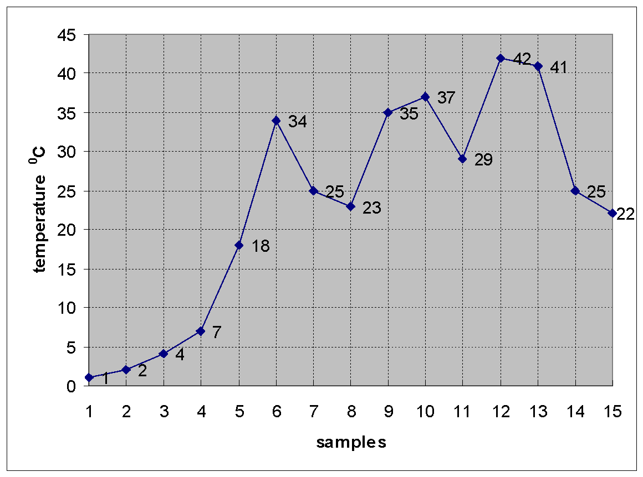
Digital Representation
Notes:
13
The reconstructed continuous signal does not give an exact replica of the original.
The reconstructed signal has sharp edges and corners in contrast to the original signal which has smooth curves.

Slide 14
Electronic Processing
Analogue Systems
Digital Systems
Representing quantities in Digital Systems
Notes:
14
Electronic processing of these continuous and digital quantities requires that these quantities be converted into and represented in term of voltages.
Analogue Electronic Systems deal with electronic signals or voltages that are continuous and represent continuous quantities.
Thus a temperature transducer converts a continuous temperature of 39 ⁰C into 39 mVs and 42.75 ⁰C into 42.75 mVs.
Digital Electronic Systems on the other hand deal with discrete electronic signals or voltages that represent discrete or digital values.
How does a digital system such as a calculator process the number 39? Do the Digital systems represent discrete values in terms of voltages? Lets have a look.
One possible solution is to calibrate the electronic circuitry of the calculator to represent the number 1 by 1 mV. The number 10 is represented by 10 mV. The number 39 is represented by 39 mV.

Slide 15
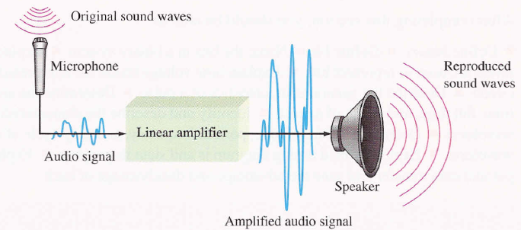
Analogue Systems

Slide 16
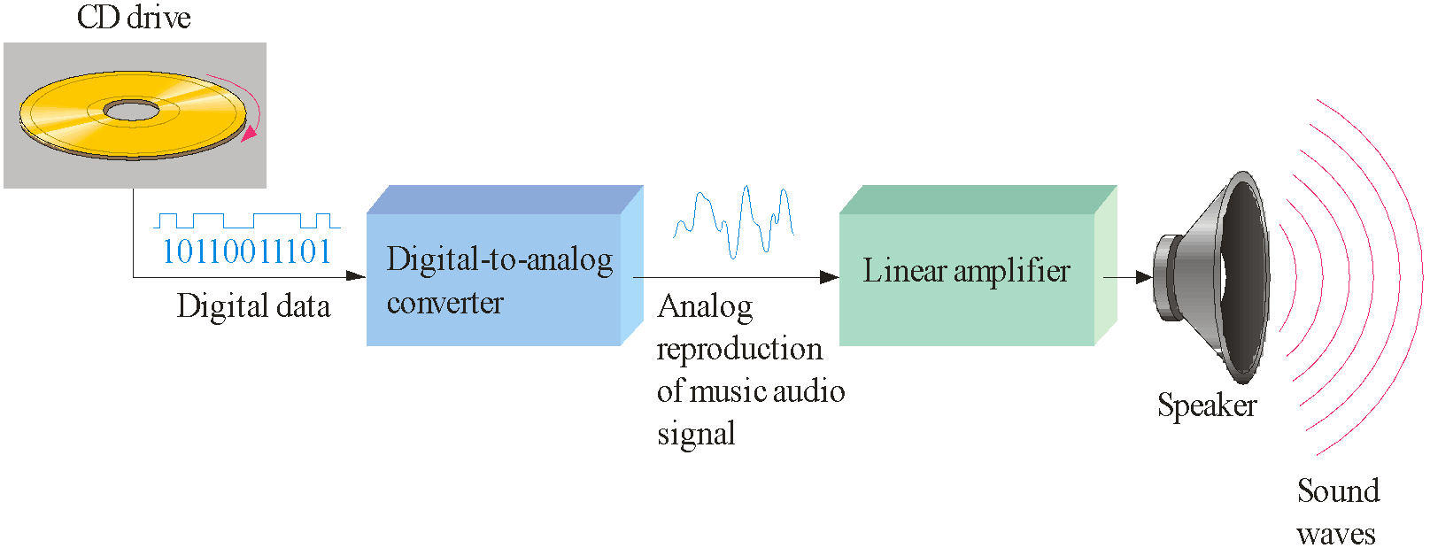
Digital and Analogue Systems

Slide 17
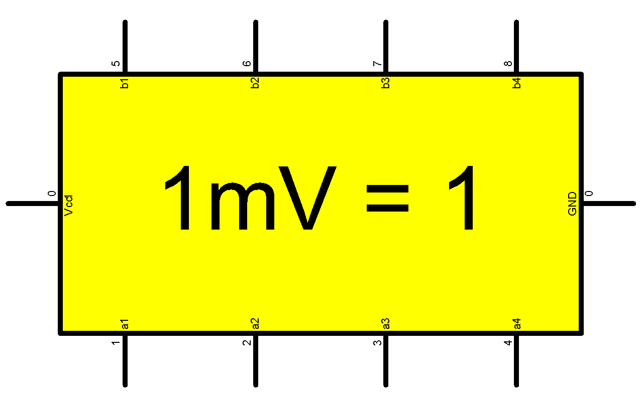
Representing Digital Values
39 ⁰C ?
Digital System
39mV
6.25 x 10¹⁵ V !!
6.25 x 10¹⁸ ?
Notes:
17
Consider the Calculator which is an example of a Digital system.
Let us assume that the calculator has been internally calibrated to represent the number 1 by 1mVolts.
Thus a number or temperature value 39 is represented by the calculator in terms of a voltage value as 39 mVolts.
Calculators can also handle a large values such as 6.25 x 10¹⁸ the number of electrons in 1 Coulomb of charge.
This large value represented in terms of voltage by the calculator, turns out to be 6.25 x 10¹⁵ volts, which is a very large voltage value and can not be practically represented by any circuit.

Slide 18
DLD
Notes:
18
Digital systems use electronic circuitry that only works with two voltage levels. The two voltage levels represent two states. A voltage level of 5v represents logic high or logic 1 state and a voltage level of 0v represents logic low or logic 0 state.
The two states in a digital system can represent any two quantities, the numbers 0/1, on/off, black/white, hot/cold, moving/stationary and similar other quantities.
How does one represent more than two states in a digital system?
Such as the different shades of grey in between the colours black and white or the temperature 39 or the velocity of a moving object.

Slide 19
DLD
DIGITAL
Notes:
19
Digital systems use electronic circuitry that only works with two voltage levels. The two voltage levels represent two states. A voltage level of 5v represents logic high or logic 1 state and a voltage level of 0v represents logic low or logic 0 state.
The two states in a digital system can represent any two quantities, the numbers 0/1, on/off, black/white, hot/cold, moving/stationary and similar other quantities.
How does one represent more than two states in a digital system?
Such as the different shades of grey in between the colours black and white or the temperature 39 or the velocity of a moving object.

Slide 20
DLD
DIGITAL
LOGIC
Notes:
20
Digital systems use electronic circuitry that only works with two voltage levels. The two voltage levels represent two states. A voltage level of 5v represents logic high or logic 1 state and a voltage level of 0v represents logic low or logic 0 state.
The two states in a digital system can represent any two quantities, the numbers 0/1, on/off, black/white, hot/cold, moving/stationary and similar other quantities.
How does one represent more than two states in a digital system?
Such as the different shades of grey in between the colours black and white or the temperature 39 or the velocity of a moving object.

Slide 21
DLD
DIGITAL
LOGIC
DESIGN
Notes:
21
Digital systems use electronic circuitry that only works with two voltage levels. The two voltage levels represent two states. A voltage level of 5v represents logic high or logic 1 state and a voltage level of 0v represents logic low or logic 0 state.
The two states in a digital system can represent any two quantities, the numbers 0/1, on/off, black/white, hot/cold, moving/stationary and similar other quantities.
How does one represent more than two states in a digital system?
Such as the different shades of grey in between the colours black and white or the temperature 39 or the velocity of a moving object.

Slide 22
Digital Systems
Two Voltage Levels
Two States
On/Off
Black/White
Hot/Cold
Stationary/Moving
The Two State Number System is
Notes:
22
Digital systems use electronic circuitry that only works with two voltage levels. The two voltage levels represent two states. A voltage level of 5v represents logic high or logic 1 state and a voltage level of 0v represents logic low or logic 0 state.
The two states in a digital system can represent any two quantities, the numbers 0/1, on/off, black/white, hot/cold, moving/stationary and similar other quantities.
How does one represent more than two states in a digital system?
Such as the different shades of grey in between the colours black and white or the temperature 39 or the velocity of a moving object.

Slide 23
Binary Number System
Binary Numbers
Two Digits are 0 and 1. A binary digit is called bit
Representing Multiple Values
Notes:
23
The two states of the Digital circuits are based on the Binary number system which allows only two numbers 0 and 1.
The Binary digit is called a bit.
To represent more than two states a combination of binary bits is used.
In the decimal number system a single digit can represent 10 values from 0 to 9.
To represent more than 10 values a combination of two digits is used which allows up to 100 values to be represented.
In a binary number system a combination of 2 bits allows 4 different values to be represented.
For example the four shades are represented by two bits, 00, 01, 10, 11.
A temp of 39 is represented by a combination of six bits 100111.
The number 39 is represented in a digital system by a combination of voltage levels 5, 0, 0, 5, 5 and 5 volts

Slide 24
Merits of Digital Systems
Efficient Processing & Data Storage
Efficient & Reliable Transmission
Detection and Correction of Errors
Precise & Accurate Reproduction
Easy Design and Implementation
Occupy minimum space
Notes:
24
Let us have a quick look at the advantages of a Digital System.
Processing and Storage of digital data is efficient.
Computers are very efficient at processing information that is in digital binary form.
A CD can store large number of digitized audio and video clips. Storing same number of audio or video clips in an analogue form requires a large number of audio or video cassettes.
Transmission of digital data is efficient and reliable and less prone to errors.
Even if an error occurs detection and correction of errors in digital data is easier.
We will be looking at a simple example of detecting errors using the parity bit method.
Digitally stored data can be precisely and accurately reproduced.
The picture quality and sound quality of digitized video or audio stored on CDs can be reproduced with a far superior quality as compared to analogue audio and video.
Digital circuits and systems are easier to design and implement.
We would be looking at some simple digital systems in the Digital Logic Design course.
Digital circuits in the form of Integrated circuits occupy very small space.
The PC has a motherboard which has an area less than 1 sq.ft but has all the important circuitry of the computer.
Digital memory implemented as an Integrated circuit small enough to fit in you hand can store an entire collection of books!

Slide 25
Information Processing
Numbers
Text
Formula and Equations
Drawings and Pictures
Sound and Music
Notes:
25
A computer which is a digital system can process different types of information
It can handle numbers and perform arithmetic operations on the numbers
It can handle text and perform editing operations on text
It can handle mathematical and scientific formulas
It can handle drawings and pictures
It can process sound and music
All this diverse types of information is represented in the form of binary numbers. Different binary standards are used to represent different types of information. For example, text is represented through binary bits, however the bits representing the characters follow a standard ASCII code

